Slide 1
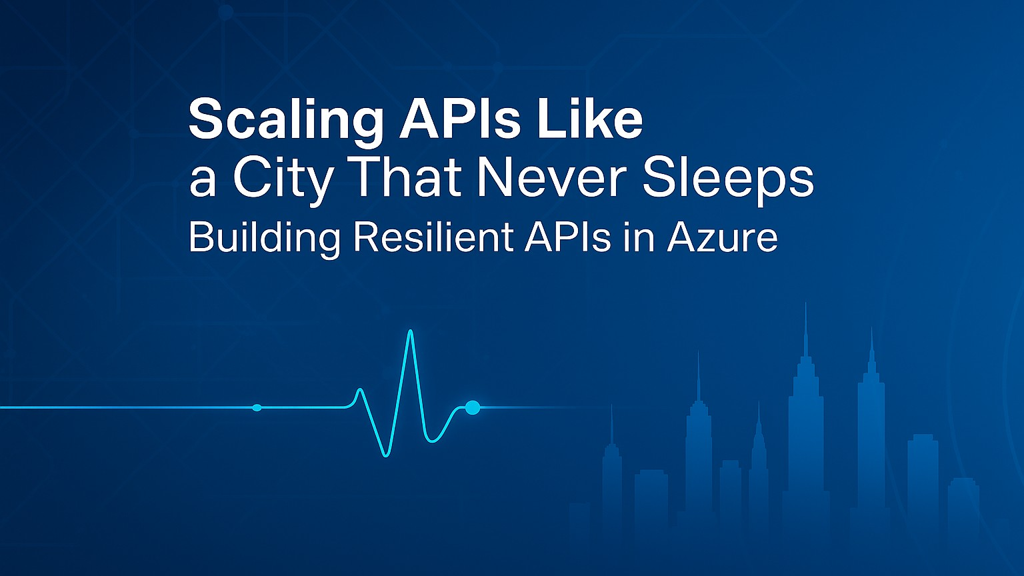
Notes:
Welcome everyone!
Today, we will explore how to design APIs that can handle anything you throw at them — whether that is a sudden traffic spike, a regional outage, or evolving business demands.
New York is a city that never sleeps — systems in constant motion, always on. The subways, the power grid, the traffic flow — all have to work together, adapt in real time, and recover quickly when something goes wrong.
By the end of this session, you will walk away with:
A clear blueprint for building APIs that stay online under pressure.
Practical Azure patterns for scaling without overspending.
Proven monitoring and recovery strategies you can implement right away.
Like New York’s infrastructure, your APIs can be designed to run 24/7, no matter what happens around them.

Slide 2








Agenda
Building Resilient and Scalable APIs in Azure
Intro & Problem Space
Azure Toolset Overview
High Availability & Disaster Recovery
Resilience Strategies
Monitoring & Observability
Live Demo
Blueprint & Wrap Up
Q&A
Notes:
Here is our roadmap for the next xx minutes.
Like navigating New York, we will start with the big picture — the map — before diving into the street-level details.
We will begin with the problem space, then explore the Azure building blocks that keep our systems moving 24/7.
From there, we will look at high availability and disaster recovery — the equivalent of alternate subway lines and backup power grids — followed by resilience strategies that keep things running even when the unexpected happens.
We will check in on monitoring an observability, run a live demo, and finish with a blueprint you can take home.
By the end, you will know how to keep your APIs as reliable as the city that never sleeps.

Slide 3
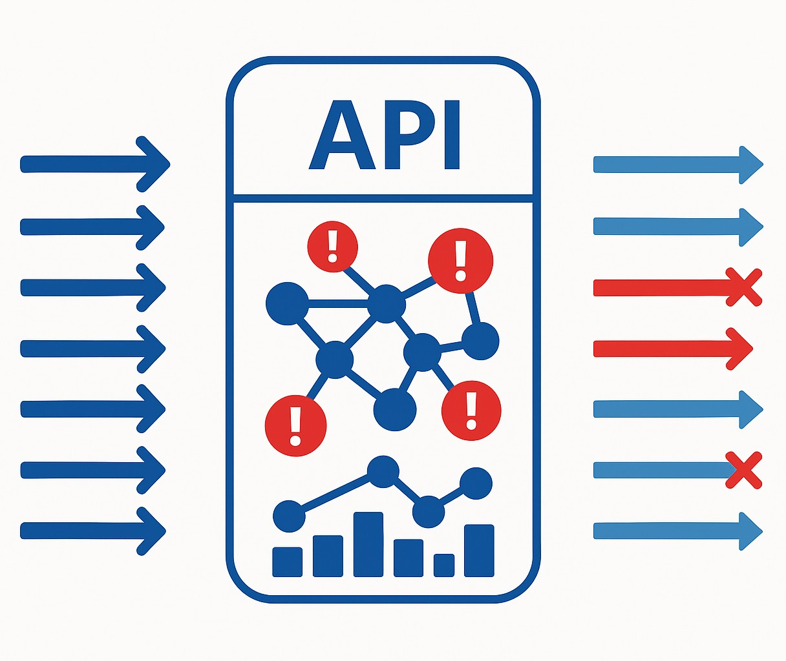

The Resilience Challenge
Building Resilient and Scalable APIs in Azure
Notes:
In New York, rush hour can turn a 10-minute trip into an hour-long crawl. One stalled train can ripple delays across the entire subway network. That is exactly how API failures behave.
Imagine your API is the seven train at peak time. A sudden surge of passengers or requests pushes it to capacity. If one station or service goes offline, the whole line backs up. And if you do not have alternate routes, people — or data —stop moving.
We have all seen it: a viral event drives traffic through the roof, an upstream service fails, or a slight latency issue snowballs into a full-blown outage. In a city that never sleeps, there is no “off-hours” to fix it quietly. Your systems have to adapt in real time.
That is the challenge we are here to solve — building APIs that can handle the chaos of rush hour, every hour.

Slide 4










Resilience Turnaround
From Fragile to Fault-Tolerant: An API Resilience Transformation
Before (Challenges)
After (Results from Azure Patterns & Services)
Legacy Stack
Unplanned Outages
Cascading Failures
Protected Gateway
Multi-Region
Smart Patterns
No visibility
Manual Recovery
Live Metrics
Scales on Demand
Notes:
Let me give you a realistic example.
There is an organization that started with a patchwork of legacy integration systems and a couple of home-grown API gateways. They were fine on a normal day, but when traffic spiked, the cracks showed. Requests piled up, upstream services failed, and without throttling or caching, these failures cascaded.
They had no real-time visibility, so they were always reacting after customers felt the pain. Every failover was manual, expensive in both time and money.
They decided to re-architect with resilience in mind, using the exact patterns and Azure services we will be talking about today. Azure API Management became their consistent front door, enforcing policies, caching responses, and shielding backends. They deployed across multiple regions with Azure Front Door, so it one region had trouble, traffic flowed seamlessly to another. They built retry and circuit breaker logic into both APIM and their service code. They also wired up Azure Monitor and Application Insights to spot trouble before users did.
The result? A platform that now takes traffic surges in stride, shrugs off upstream hiccups, and has cut downtime dramatically — all while delivering a 315% ROI. This is the kind of transformation we are aiming for in this session.

Slide 5
Azure Toolset Overview
Notes:
We have just experienced the reality of API resilience challenges — the surges, dependency failures, cascading slowdowns, and deployment risks.
You do not just hope the city will keep running in New York — you design for it. You build in alternate routes, surge capacity, and real-time control, because the city never sleeps and the demands never stop.
Resilient APIs work the same way. They are not the result of luck — they are the result of deliberate design choices that give you:
Control at the edge — like traffic lights and toll gates that keep the avenues moving.
Elasticity in the middle — like adding more subway trains when the platforms are packed.
Intelligence throughout — like the MTA’s live monitoring that reroutes trains before delays cascade.
You can build those capabilities on many platforms — Kubernetes in AKS, App Service Web Apps, even traditional VMs — and the principles will apply to all of them.
For this session, though, we will focus on serverless technologies where possible. Why? Because serverless gives us some of those resilience superpowers right out of the box:
It scales automatically with demand — like adding extra buses when the streets are busy.
It removes much of the operational overhead, so we can focus on API logic and resilience patterns — instead of maintaining the “roads and rails.”
And it aligns cost with usage, so you are not paying for empty trains at 3 a.m.
Imagine starting with a city with flexible infrastructure and on-demand transit crews. We will still add the safety systems, backup routes, and monitoring, but the base is already built to handle stress.
In this next section, we will look at the specific Azure building blocks that give us those capabilities and how they work together to create APIs that not only survive under pressure but thrive in a city that never sleeps.

Slide 6

Azure Toolset Overview
Primary Trio
Azure API Management
Traffic Shaping and Throttling
Caching
Policy Enforcement
Backend Shielding
Notes:
Let’s start at the front door of our API platform, Azure API Management, or APIM.
In New York terms, APIM is like the combination of a toll gate, a traffic cop, and a dispatcher at a major bridge or tunnel. Every vehicle — or request — passes through here first. It is where we decide who gets in, how fast they can go, and which lane they should take.
From a resilience perspective, APIM gives us several critical capabilities:
Traffic shaping and throttling: Just like metering cars onto the FDR or the Holland Tunnel so the whole system doesn’t gridlock.
Caching: Serving repeat requests from memory, the way a MetroCard tap speeds you through without re-processing every fare
Policy enforcement: Applying consistent rules for authentication, transformation, and validation, like a uniform set of traffic laws across all boroughs.
Backend shielding: Insulating fragile or high-latency services from rush-hour traffic chaos.
This is where we can implement circuit breakers, retries, and failover routing at the edge — stopping problems before they cascade deeper into the system.
And because APIM is a single, consistent entry point for all APIs, we can roll out resilience patterns once and have them apply everywhere — the same way a citywide traffic control system can adjust signals across all neighborhoods at once.
In short, APIM is our first line of defense and our first opportunity to optimize. It is where we absorb the initial shock of a traffic surge, gracefully handle upstream issues, and keep the rest of the platform stable — just like New York keeps it arteries flowing even when the pressure is on.

Slide 7

Azure Toolset Overview
Primary Trio
Azure API Management
Azure Functions
Elastic Capacity
Scale-to-Zero Efficiency
Event-Driven Triggers
Isolation of Workloads
Notes:
After APIM has managed the flow at the front door, we need a way to handle the work itself when demand changes instantly.
In New York terms, Azure Functions is like the extra subway trains or buses that appear during rush hour — or the street crews that show up overnight to fix a problem, then disappear when the job’s done.
From a resilience perspective, Functions gives us:
Elastic Capacity — like adding more trains to clear a crowded platform.
Scale-to-zero efficiency — no empty trains running at 3 a.m.
Event-driven triggers — responding to signals instantly, without constant patrolling.
Isolation of workloads — each “crew” works independently, so one delay doesn’t shut down the whole city.
It’s our on-demand workforce — always ready, never idle, and able to respond instantly when the city calls.

Slide 8

Azure Toolset Overview
Primary Trio
Azure API Management
Azure Functions
Azure Container Apps
Granular Scaling
Multiple Scale Triggers
Revisions and Blue-Green Deployments
Service-to-Service Communication
Notes:
After APIM has managed the flow at the edge and Functions has given us elastic, on-demand bursts of compute, we need a way to run the core services that keep the city moving all day, every day.
In New York terms, Azure Container Apps is like the subway lines that run continuously — but can add more trains when the platforms are crowded or adjust routes when there is a disruption.
From a resilience perspective, Container Apps gives us:
Granular scaling — like adding or removing trains based on passenger load.
Multiple scale triggers — responding to real-time signals, not just a fixed timetable.
Revisions and blue-green deployments — like testing a new service pattern on one line before rolling it out citywide.
Service-to-service communication — secure, internal “track connections” between lines without sending passengers into street traffic.
It is our flexible backbone — always running, but able to adapt instantly when the city’s needs change.

Slide 9







Who is Chad Green?
chadgreen@chadgreen.com
TaleLearnCode
ChadGreen.com
ChadGreen & TaleLearnCode
ChadwickEGreen

